Slide 1
REACT.JS
COMPONENTS
SHALOM MATHEW

Slide 2
Components in React

Slide 3

What is React Composed of?
Components
Building blocks of the UI
Small, independent, and reusable
Contain rendering instructions for the virtual DOM (usually written in JSX)

Slide 4
What is Component?
Components are independent and reusable bits of code. They serve the same purpose as JavaScript functions, but work in isolation and return HTML. Components come in two types, Class components and Function components, in this tutorial we will concentrate on Function components

Slide 5

Functional Component
import React from "react"
function Welcome() {
return (
<div className="Welcome">
<img src="https://tinyurl.com/GDISFbanner"/>
<h1>Hello, React GDI!</h1>
</div>
)
}
Hello, React GDI!
Notes:
These can have special features, like internal state and a constructor. (Note: State can manage changes to a component based on user input, and constructor helps with initializing state. More on that later!)

Slide 6
Functional Components
Need to import React at the top of the file
Unlike regular JS functions, component names begin with a capital letter
import React from "react"
function Welcome() {
return (
<div className="Welcome">
<img src="https://tinyurl.com/GDISFbanner"/>
<h1>Hello, React GDI!</h1>
</div>
)
}
Functional components always contain a return statement with HTML
Other elements may be nested inside, but there is always one top level HTML element
Hello, React GDI!

Slide 7
Class Components
import React from "react"
class TodoApp extends React.Component {
render() {
return (
<div>
<h3>Class</h3>
</div>
);
}
}
Hello, React GDI!

Slide 8
Component Composition
Composition of components refers to nesting components inside one another
Nest default HTML elements like <div />, and/or your own React components
function Welcome() {
return (
<div className="Welcome">
<img src="https://tinyurl.com/GDISFbanner"/>
<Greeting />
</div>
)
}
function Greeting() {
return (
<h1>Hello, React GDI!</h1>
)
}
Same component as before, but now with nesting!
Hello, React GDI!

Slide 9
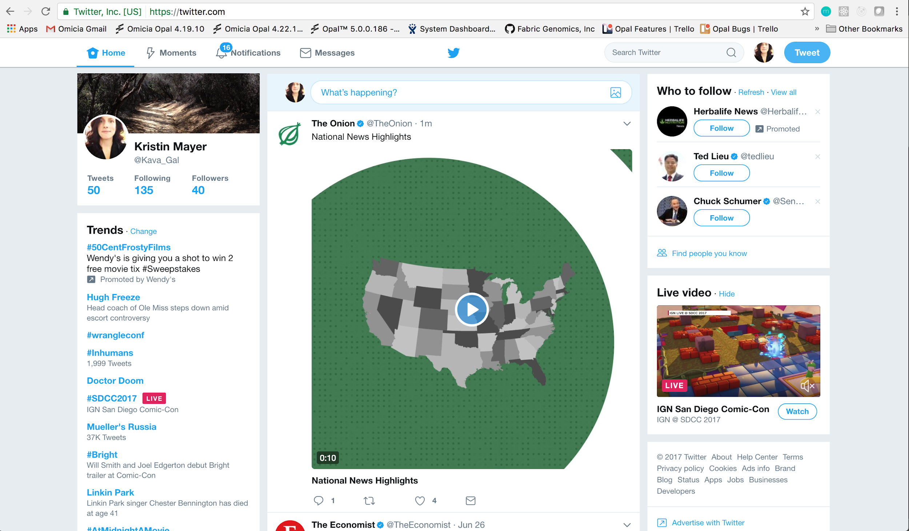
Exercise: How would you design Twitter?
If you were to build Twitter in React, what would it look like? Can you name the components you’d choose?
Notes:
Identify components that you would create
How did you decide what to break up?
Group exercise - whole class

Slide 10
Exercise: How would you design Twitter?
Notes:
Identify components that you would create
How did you decide what to break up?
Group exercise - whole class

Slide 11
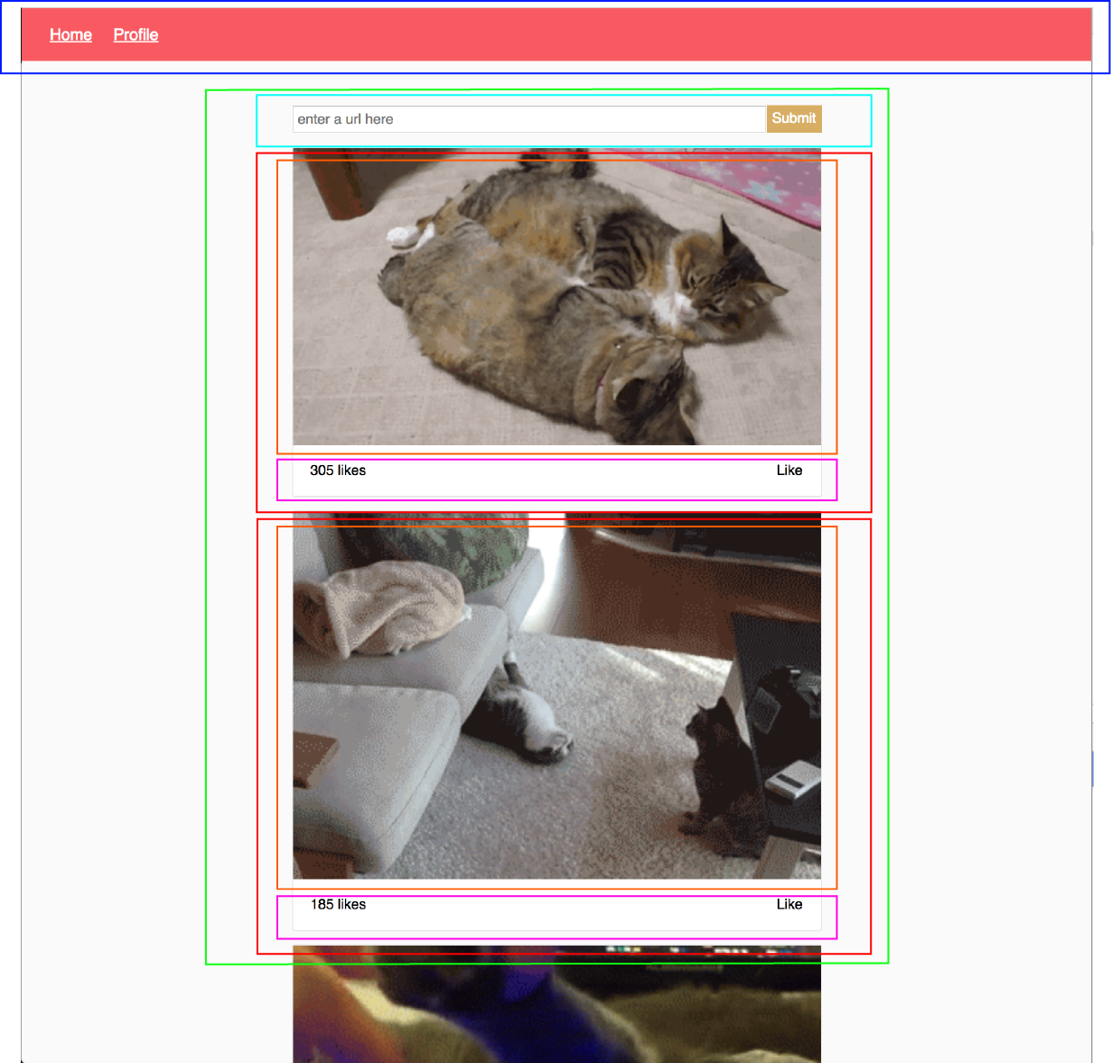
Thinking in React
When planning your application, it’s helpful to draw out your app and determine its components.

Slide 12
Thinking in React
Think:
Reusable components
Nested components
One-way data flow (in the form of props from the parent to the child… more on this later!)
Notes:
One-way data flow means you can only get information from the parent component (in the form of props)
Paired exercise: purple bounding box is <App />
Name all the other components, and put them in hierarchical order

Slide 13
What is React Composed of?: Components
Components
In the case of React 18, specifically Functional Components
Rendering components:
Must attach it to the DOM using ReactDOM.render()
Can also render a component within another component!

Slide 14
What is React Composed of?: JSX
What is JSX?
Javascript Syntax Extension
Looks a lot like a template language, like HTML
Describes what we want the UI to look like
How does JSX work?
Creates React “elements” we can render to the DOM alongside HTML
Combines markup (HTML) and logic (JS) into one element: a component
Notes:
Technically “XML-like syntax”
What is XML? Extensible Markup Language (XML) is a markup language that defines a set of rules for encoding documents in a format that is both human-readable and machine-readable.
Hfnotes: better explanation as to why we need JSX and what is it - previously, js and html were separate, but wouldn’t it be better if we could easily mix the two to make writing components easier

Slide 15

JSX = HTML(ish) + JS
Logic can be contained within {} ‣ this can be any valid JS expression (i.e. one-liner)
function MyComponent() {
const myLanguages = ['JSX', 'HTML'];
return (
<div className="MyComponent">
<h1>Hello, world! I am a Component!</h1>
<p>I’m made up of {myLanguages.join(' & ')}!</p>
</div>
);
}
JSX
Notes:
Change 1+1 to various JS expressions

Slide 16
JSX = HTML(ish) + JS
JSX can be any valid JS expression (i.e. one-liner). IE:
Variables:
const myLanguages = ['JSX', 'HTML'];
<p>I’m made up of {myLanguages.join(' & ')}!</p>
Function calls:
const format = (array) => array.join(' & ')
<p>I’m made up of {format(myLanguages)}!</p>
Terneray:
<p>I’m made up of {myLanguages ? format(myLanguages) : ‘code’ }!</p >
Notes:
Change 1+1 to various JS expressions

